Slide 1
12/18

Slide 2
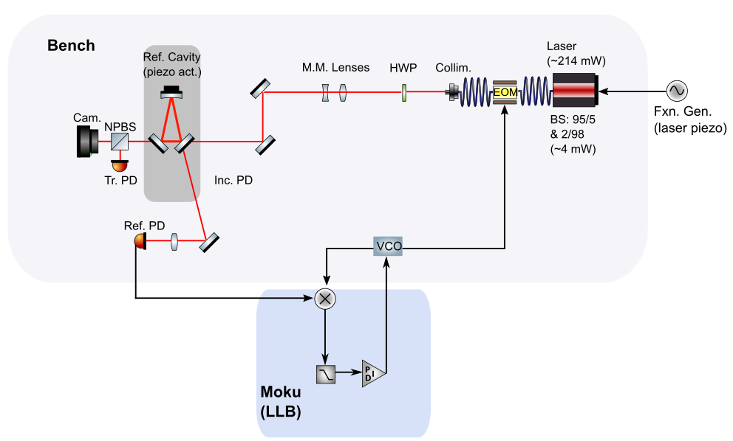
Optical truss sideband locking
Closed the loop
Moku LLB error fed back to VCO, to drive EOM and sideband lock
Brief (~1 minute) sideband lockings achieved using Moku LLB and laser piezo actuation, with laser freq. adjustment
Quickly drifts out of sideband resonance, will require optimization

Slide 3
Simulations (RX/Long-arm TTL)
Expanding simulation parameter space
More agreement check of Alex/Paul formulations
Verification of regular vs. total LPS performance for long-arm IFO
Contrast comparisons
Investigate total LPS limitations
Not trivial calculation in Paul’s current formulation
Material for annual write-up
Plots showing agreement Alex/Paul/Paul F(numerical TH-HG00 check)
Probably not timing or expansion order variation (Paul)
Plots for shot noise, contrast (Alex)

